Slide 1
Testing Protocol 2.0: Voting
Natasha and Mark

Slide 2
Step 1: Focus group questions to gauge voting interest/conventions/etc
In the first section of this evaluation, previously identified activist users would answer questions about how they vote within their activist group, what voting techniques they find particularly useful and what strategies hinder progress. Questions would be presented in two formats:
A Survey style questionnaire asking various questions with responses given on the Likert scale (1 to 5)
An open discussion with focus group members going through each survey question and expanding upon where necessary. This section would be audio recorded.

Slide 3
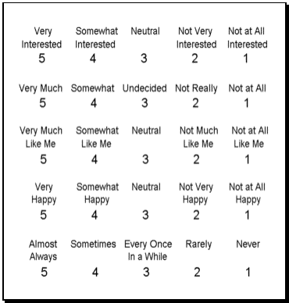
The Likert Scale

Slide 4
Sample Survey Questionnaire
How often do you use a range voting system (voting by assigning a point value to particular proposals) - Likert Scale response
When you vote within your activist group, how do you often vote on multiple proposals at once (ie a ranking system where multiple proposals can be accepted, not just one)? - Likert Scale response
When voting in your activist group, how often are the vote options simply approve or deny? - Likert Scale response
When voting in your activist group, how often are there greater than two options to vote on? - Likert Scale response

Slide 5
Sample Discussion
Experimenter: Let’s go around and talk about the first question, “how often do you use a range voting system?” Does everyone understand the question?
All: Yes (or murmurs that indicate yes)
Experimenter: Great! Activist 1, how did you respond?
Activist 1: I said that we often use a range system when voting on proposals because it’s a great way to compare the large numbers of proposals we receive.

Slide 6
Sample Discussion (cont.)
Activist 2: Oh really? We’ve never used a range voting system before. It always seemed like the points allocation would be pretty arbitrary. We prefer to do simple approve or don’t approve votes on each proposal because we feel that it give us more concrete progress.
Activist 1: That’s very interesting. I have noticed that we don’t necessarily make that much concrete progress with the range voting system since proposals often have the same number of points on average creating uncontrollable ties. Then we usually revert back to approve disapprove voting. Sometimes range voting is frustrating because it can be a huge time waster but at least we get to some more feedback from our activist group

Slide 7
Step 2: Expose the activists to AppCivist
Give activists a brief idea of what the app is about by showing them Abbie’s new opening screen.
Give the user a use case scenario:
eg Suppose your activist group wants to address a new issue, “Should bananas be sold at the Food Collective?” You have been chosen to set up AppCivist for group communication and voting process around the issue.
Walk us through how you might do this. It’s totally okay if you’re confused or don’t know where to get started. You’re welcome to click around etc.
Ask activists to voice any feedback or confusion they have with the app as they go along.
Draw extra attention to the voting process either by mentioning that that’s what we want feedback on or by asking a few open-ended questions about the voting process.

Slide 8
Step 3: Ask users to evaluate the voting component of the app through a survey
Similarly to the first survey, this survey would ask questions about voting in an activist group specifically directed at AppCivist.
Following the survey, it would be collected and users would be asked to reflect on their thoughts in a group setting. In order to garner more feedback and make sure all users are engaged, activists would first be paired in two person groups to share their thoughts.
These two person groups would then be asked to share what they talked about with the group. Open discussion would be encouraged.
This section would be audio recorded.

Slide 9
Sample Follow-up Questionnaire
After my exposure to AppCivist:
I feel confident that AppCivist meets the needs of my activist group. - Likert Scale response
I am still confused about randomly selected juries. - Likert Scale response
I like having many options for how the vote will take place. - Likert Scale response
I can see my activist group using more than one of these voting strategies. - Likert Scale response
My activist group’s voting procedure seems more efficient than the AppCivist procedure. - Likert Scale response
Notes:
what are the big questions and which more specific questions are related to the big questions
hold interviews
think of all questions in terms of functionalities (eg prop making, voting, deliberation, assembly making incl worknig groups and campaigns)

Slide 10
Sample Guided Follow-up Discussion
Experimenter: Let’s share what we talked about in our pairs. What did you all think of AppCivist’s voting platform? Could you see your activist group or another activist group using it?
Activist X: We talked about how we really liked having many options for voting. We had never thought of using anything else for voting except approve/deny but as we were talking we realized that range voting could allow greater efficiency and clarity, especially when we have to do multiple vote for the same thing.
Activist Y: That’s so true! Last time the BSFC held a vote, we ended up tabling the vote to our next meeting because no one understood how vote objections worked. It could be nice to have some outside body governing the voting process so we don’t have to focus our time on logistical matters like that.

