Slide 1
Use Case Storyboard
AppCivist
Natasha and Mark
Notes:
for Documentation

Slide 2
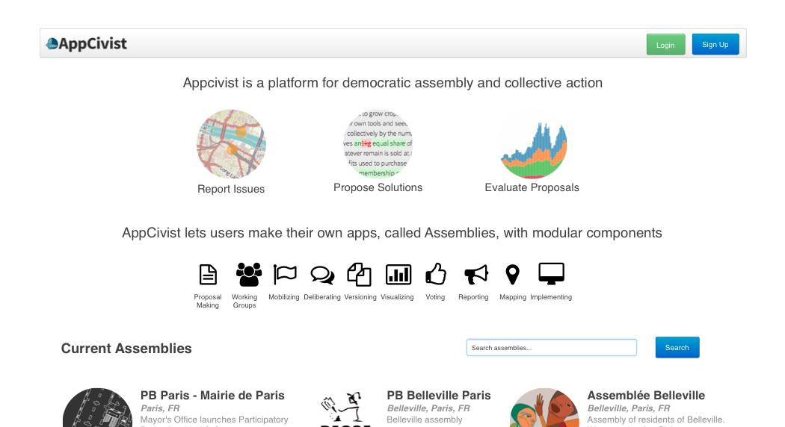
Malik is an activist passionate about food justice who has just discovered AppCivist, a modular platform for creating online communities looking to achieve their goals.

Slide 3
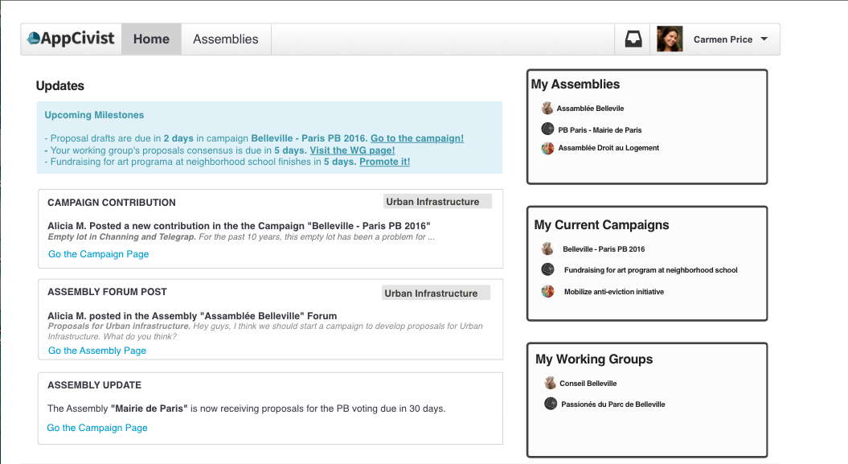
Malik signs up for AppCivist and is brought to the home page.

Slide 4
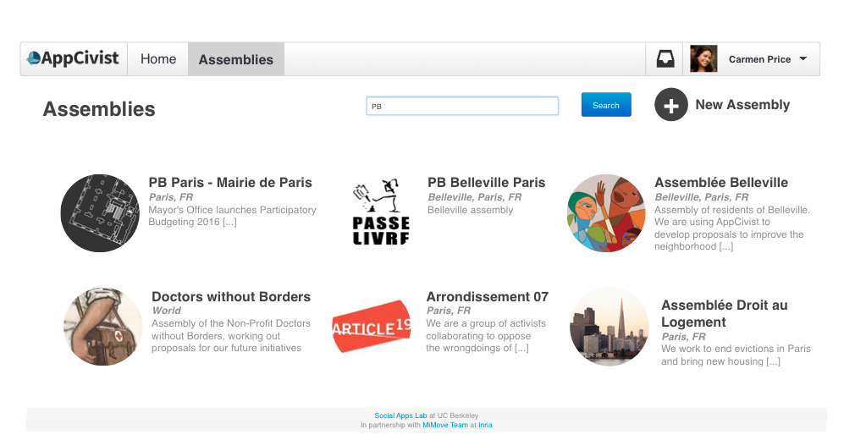
Malik clicks on the Assemblies tab to see what else AppCivist has to offer!

Slide 5
On the Assemblies page, Malik clicks the new Assembly button to create one for his activist group.

Slide 6
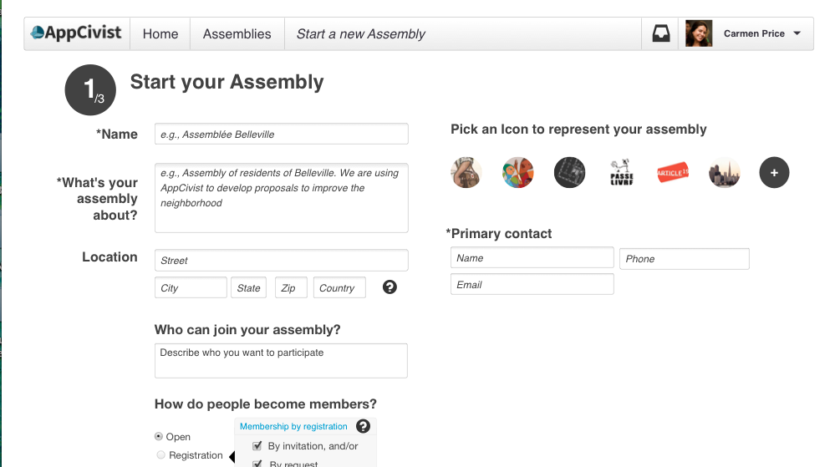
On the Assembly creation page, Malik gets to configure his assembly to his specifications.

Slide 7
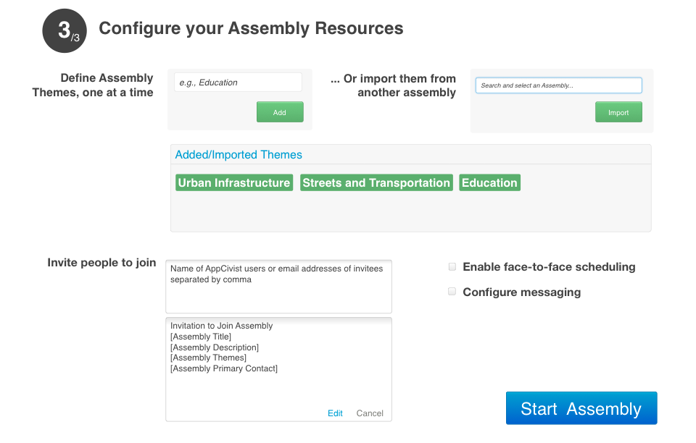
On the next page, Malik sets some themes for his assembly.

Slide 8
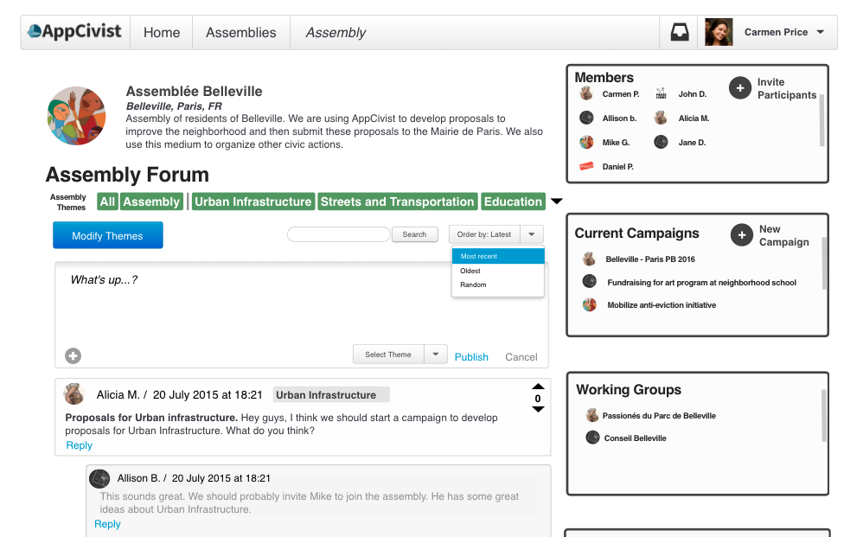
Finally, Malik’s assembly is complete! He is brought to the Assembly forum page where members can chat and collaborate.

Slide 9
Malik creates a new campaign to address the issue of the empty lot on Telegraph.

Slide 10
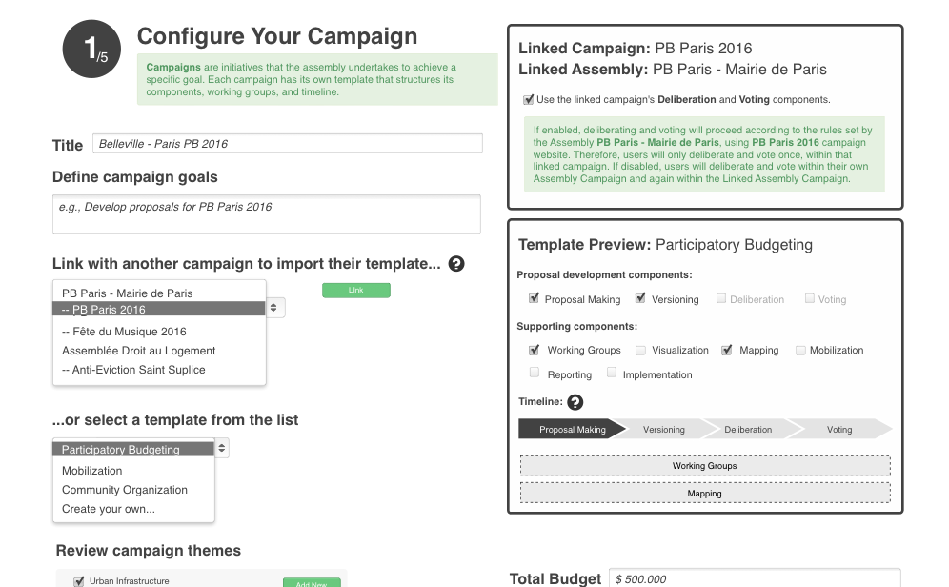
On the campaign creation page, Malik configures the campaign, sets a name, and chooses a template to organize the deliberation process.

Slide 11
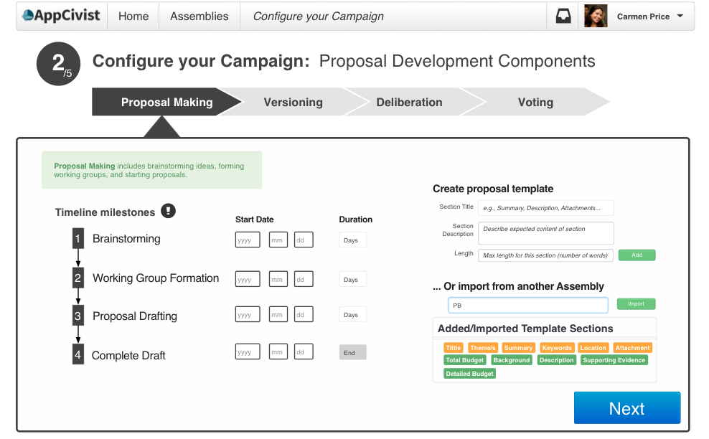
After the initial setup, Malik configures each part of the deliberation process!

Slide 12
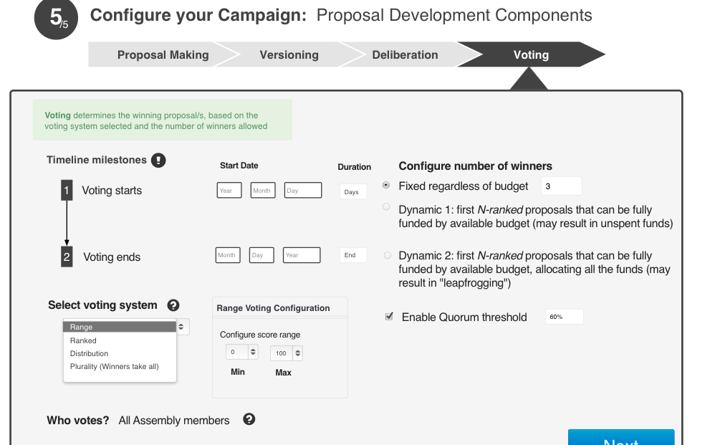
On the final step, Malik chooses a voting process for members to use.

Slide 13
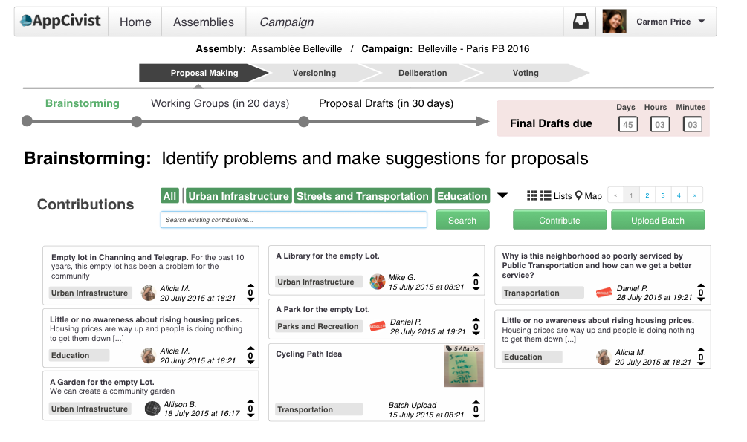
Finally, Malik is brought to the campaign forum page, and is informed that they are in the brainstorming phase of proposal making.

Slide 14
Malik clicks contribute to add his own ideas and clicks others’ ideas to learn more.

Slide 15
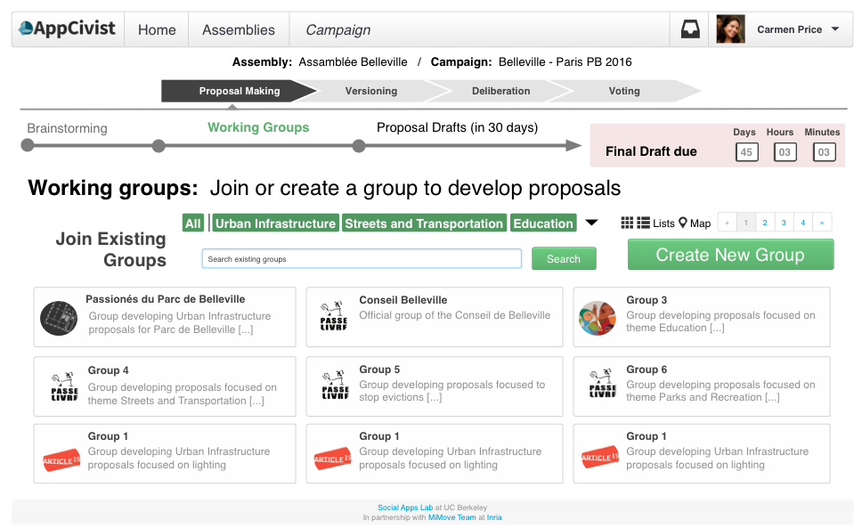
After the brainstorming deadline, the campaign transitions into working groups.

Slide 16
Malik creates a new working group to address the issue of the empty lot on Telegraph.

Slide 17
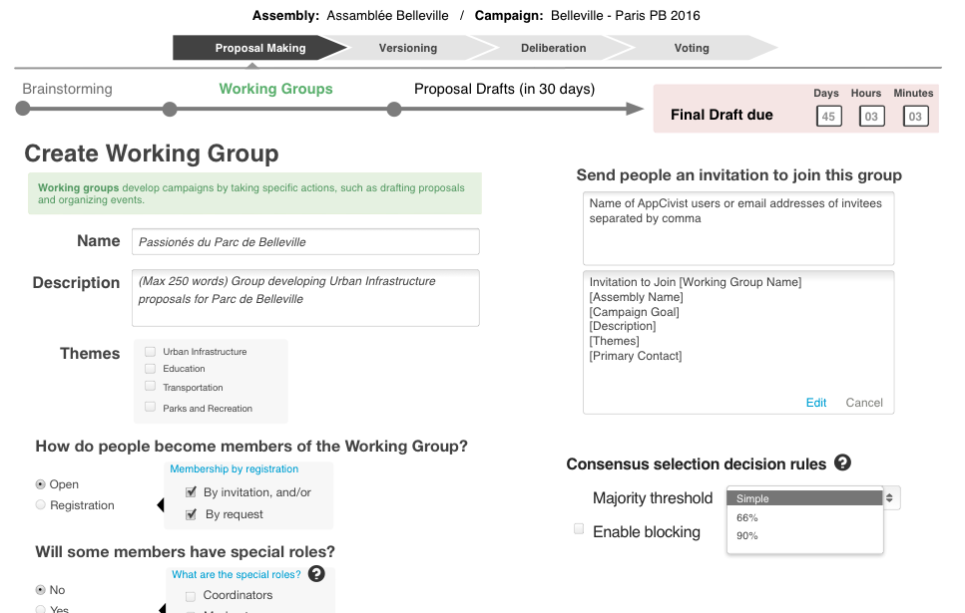
Malik configures the working group and invites some friends.

Slide 18
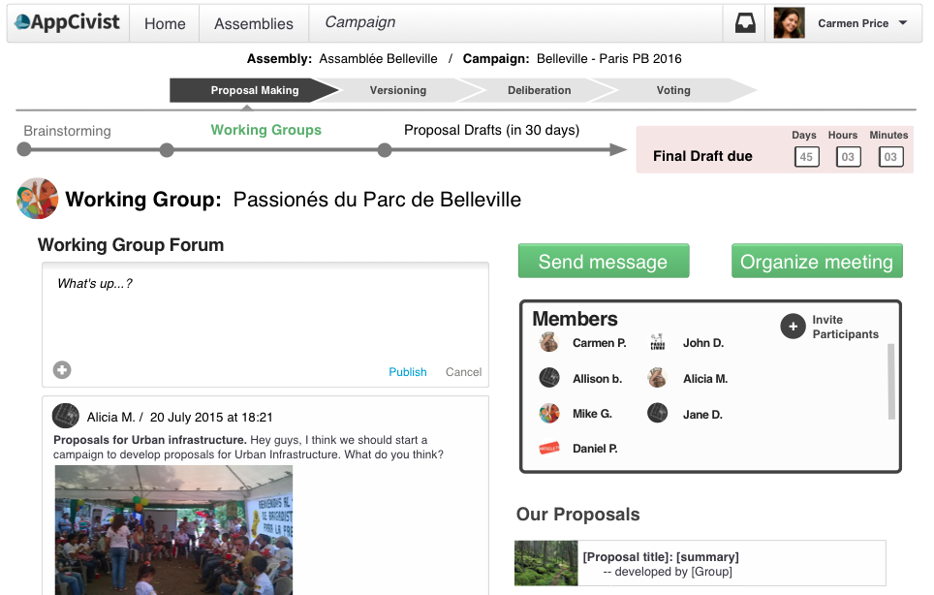
Next, Malik is brought to the Working Group Forum page.

Slide 19
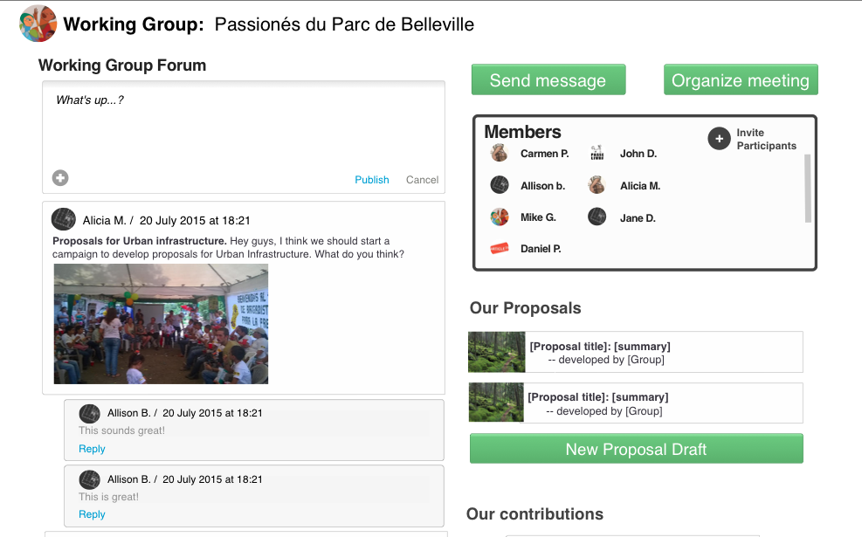
Here, Malik creates a new proposal for his working group to work on.

Slide 20
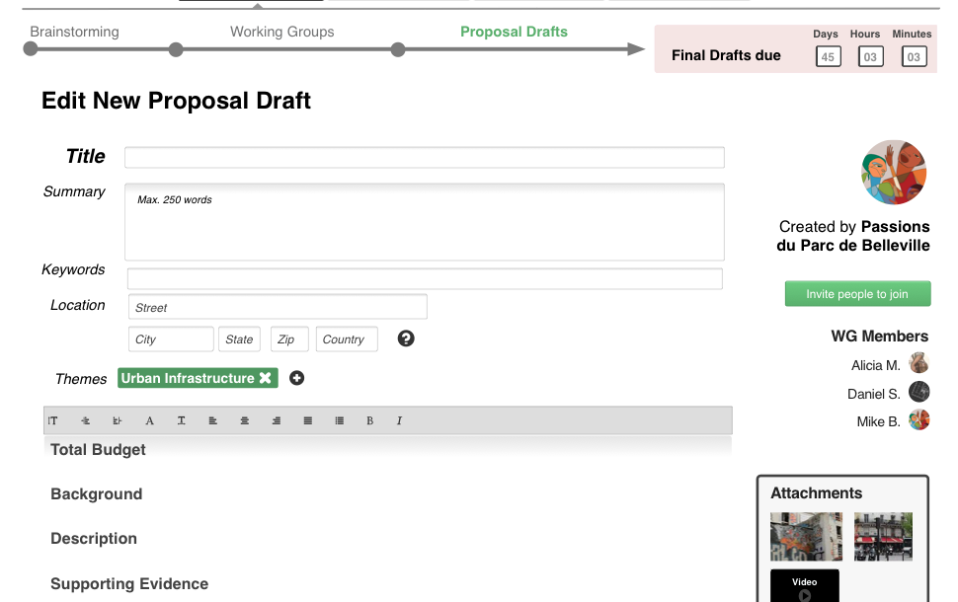
Malik and all working group members can edit the proposal, and after a few days it’s finally complete!

Slide 21
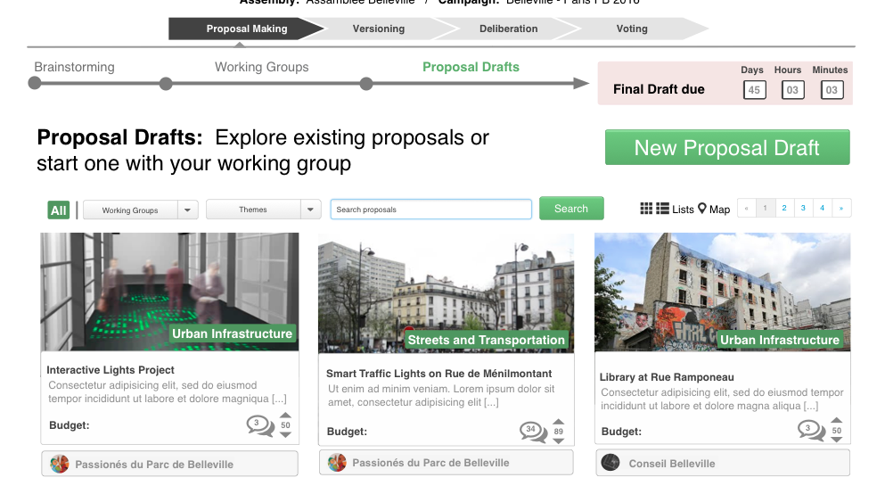
In the meantime, other working groups have been creating proposals too! These selected proposals become versions.

Slide 22
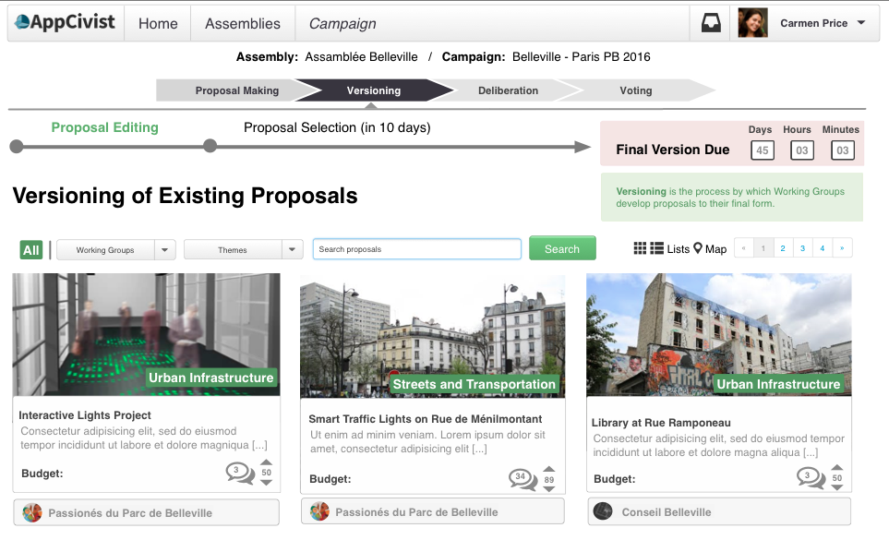
The campaign has officially moved into the versioning phase, where working groups can continue to edit their proposals but also make comments on others.

Slide 23
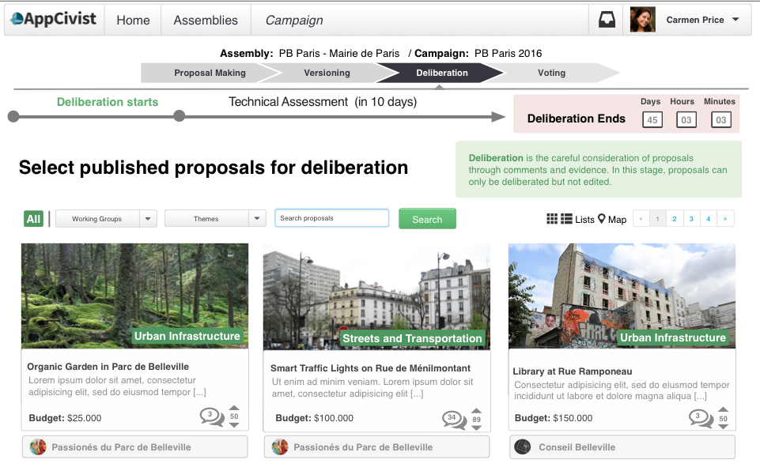
After “Versioning” is over, the campaign moves to “Deliberation”, where all assembly members view and comment on proposals.

Slide 24
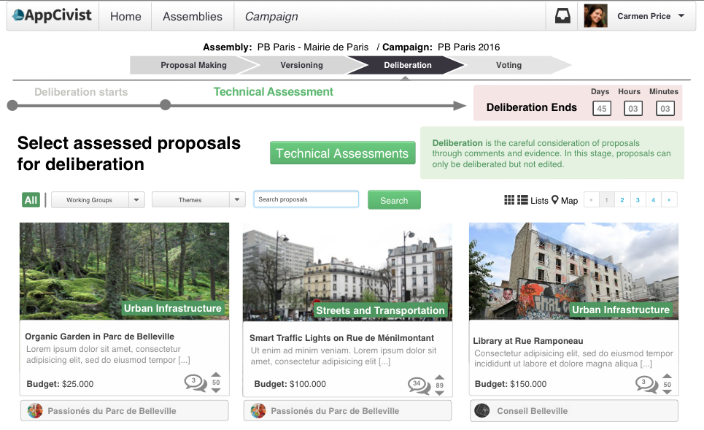
Malik assigns his friend Sasha to complete the technical assessment of the proposals during the deliberation period.

Slide 25
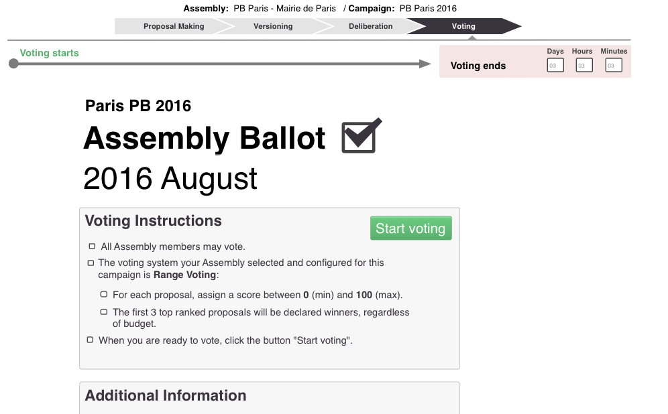
Finally, it’s time to decide which proposal to act on! The end of the deliberation period leads to voting.

Slide 26
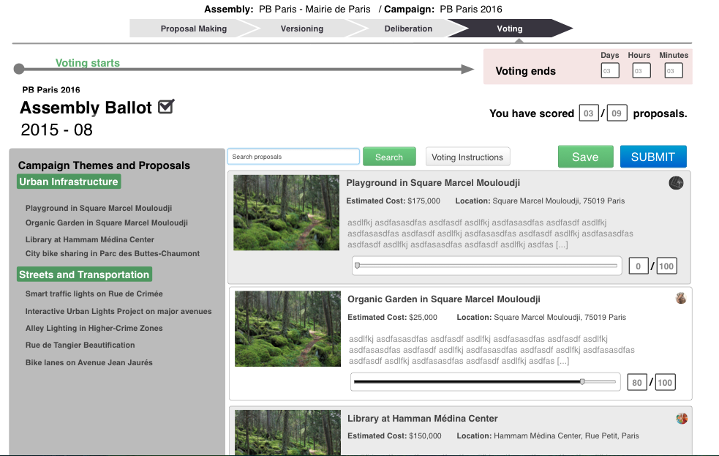
Malik chose range voting, so each participant assigns a score to each proposal (out of 100).

Slide 27
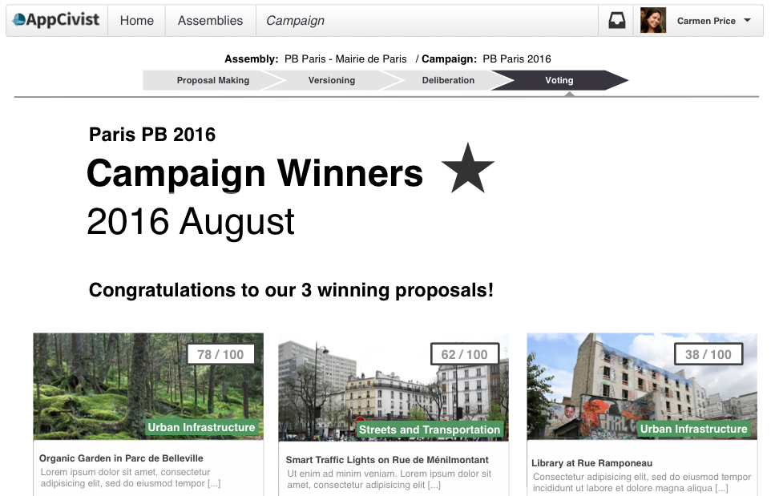
As the voting period comes to a close, the winners are announced! Malik’s proposal is a winner!

